Slide 1
…world is as we are
Notes:
What do…
Monterrey Bay Aquarium
African Photo Safaris
Burning Man
…have in common?
They are all defined by (expensive) hosting protocols created to preserve them and provide unique, immersive, meaningful opportunities to influence the perspective of; yourself, our shared eco-system and wildlife habitat. This new understanding goes home with you and can affect the way you now see the world within and around you.
This is why…how we host the traveler will determine how well a destination thrives or survives. (and Earth is our collective destination)

Slide 2
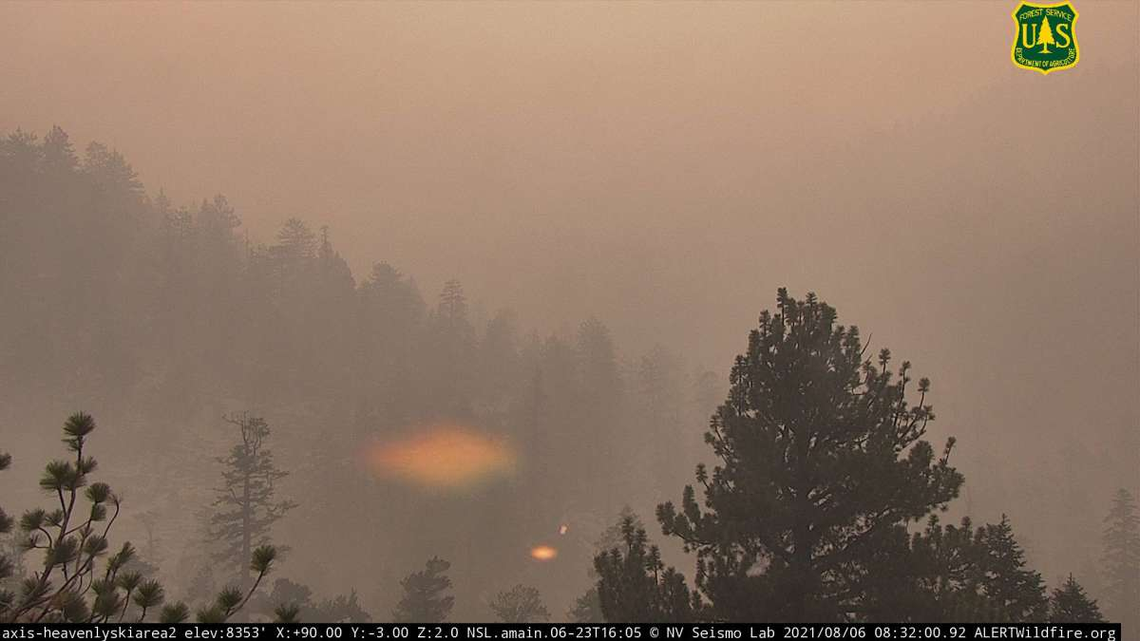
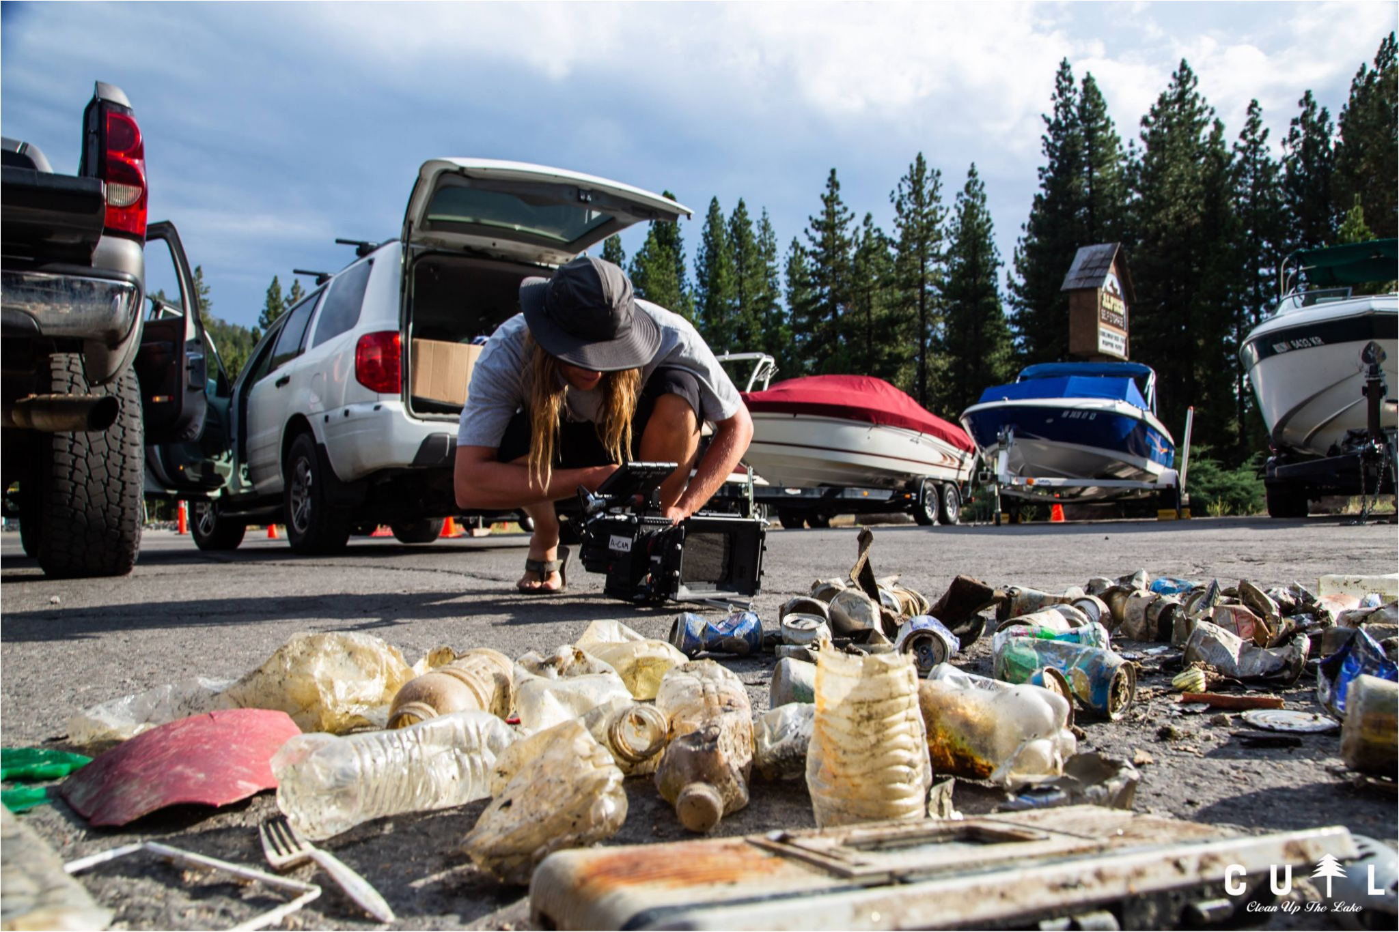
Yes, our ‘best thinking’ got us here
Notes:
How can we expand our capacity to absorb the ever growing influx of travelers without further harming the Lake and the quality of life for residents, including wildlife?
(like Bears)

Slide 3
Resorts
Clubs
What changed?
Friends
Tahoe (destination)
Events
…in guiding travelers expectations to ..and behavior in …a destination
Who was marketing, hosting, influencing visitor behavior?
DMO-
Destination Marketing Organizations
Conferences
Events
Airbnb
Climate
Media
Conferences
Friends
Twitter
VRBO
Who is now marketing, hosting influencing visitor behavior?
Everything!
Concerts
STR
DMO
NGO’s
TikTok
Hotels
Resorts
Clubs
Social Media
Notes:
PAST: Once upon a time…DMO’s – Destination Marketing Organizations, resort concierges and visitor centers guided visitors. They directed and managed a destination's brand, hosting and visitor adventure/activity/attraction menu. This set the tone/expectation of what a traveler could find, do and the best places to eat, sleep, shop and play.
NOW: YOU are the ‘DMO’ via (your iPhone/android computer) driven by social media and diversified lodging (ie; VTR’s vacation rentals). DMO's and resort concierges now respond to public requests based on what they saw online rather than being the major source to direct visitor choices and behaviors.
FUTURE: Stewardship-inspired influencers (people dependent on a future with; clean water, healthy habitat and fresh air)… will influence transit and adventure choices geared to sustaining a destinations precious assets

Slide 4
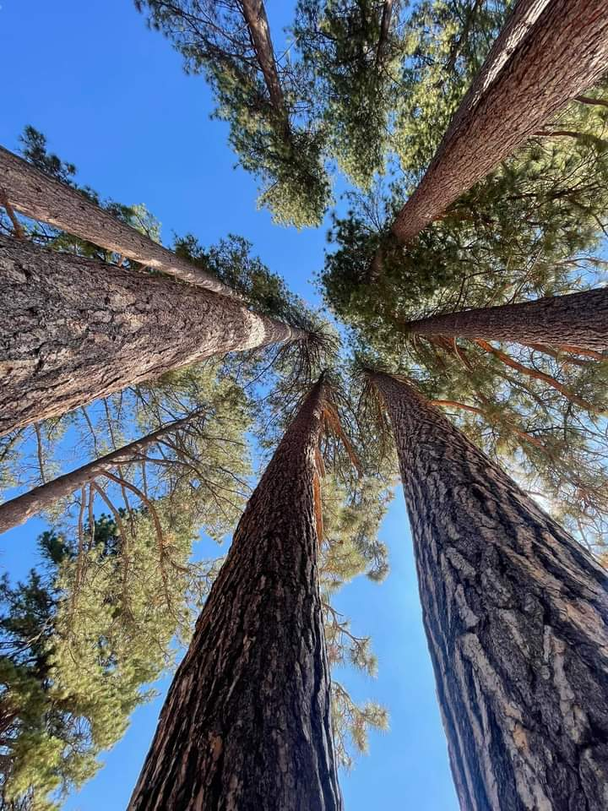
RESPONSIBLE
TRAVEL
= Long Term Prosperity
Notes:
Travelers have always played a part in sustaining destinations economically, but what if they became the solution that ensured the long-term prosperity of a destination?
Destination stewardship is a long game! Like the millennium forest projects – we start now so future generations have a framework to continue.
A Geotourism Implementation Framework considers:
Carrying Capacity
Indigenous Knowing
Sustainability filters to determine appropriate activities
TriNomic hosting commitment and collaboration
Field-based certification course that defines destination leadership positions supporting and shifting the DMO model
(2007 Ms Chandler was appointed by the NGCSD to be the Geotourism Liaison for the Tahoe region. Along with other concerned citizens, Sustainable Tahoe was founded (as a vehicle to facilitate the adoption of the 4 steps and 12 principles of Geotourism). In the process, more has been added to the formula. This 15 year ongoing facilitation has demonstrated its ability to guide visitor behavior and influence stakeholders.)

Slide 5
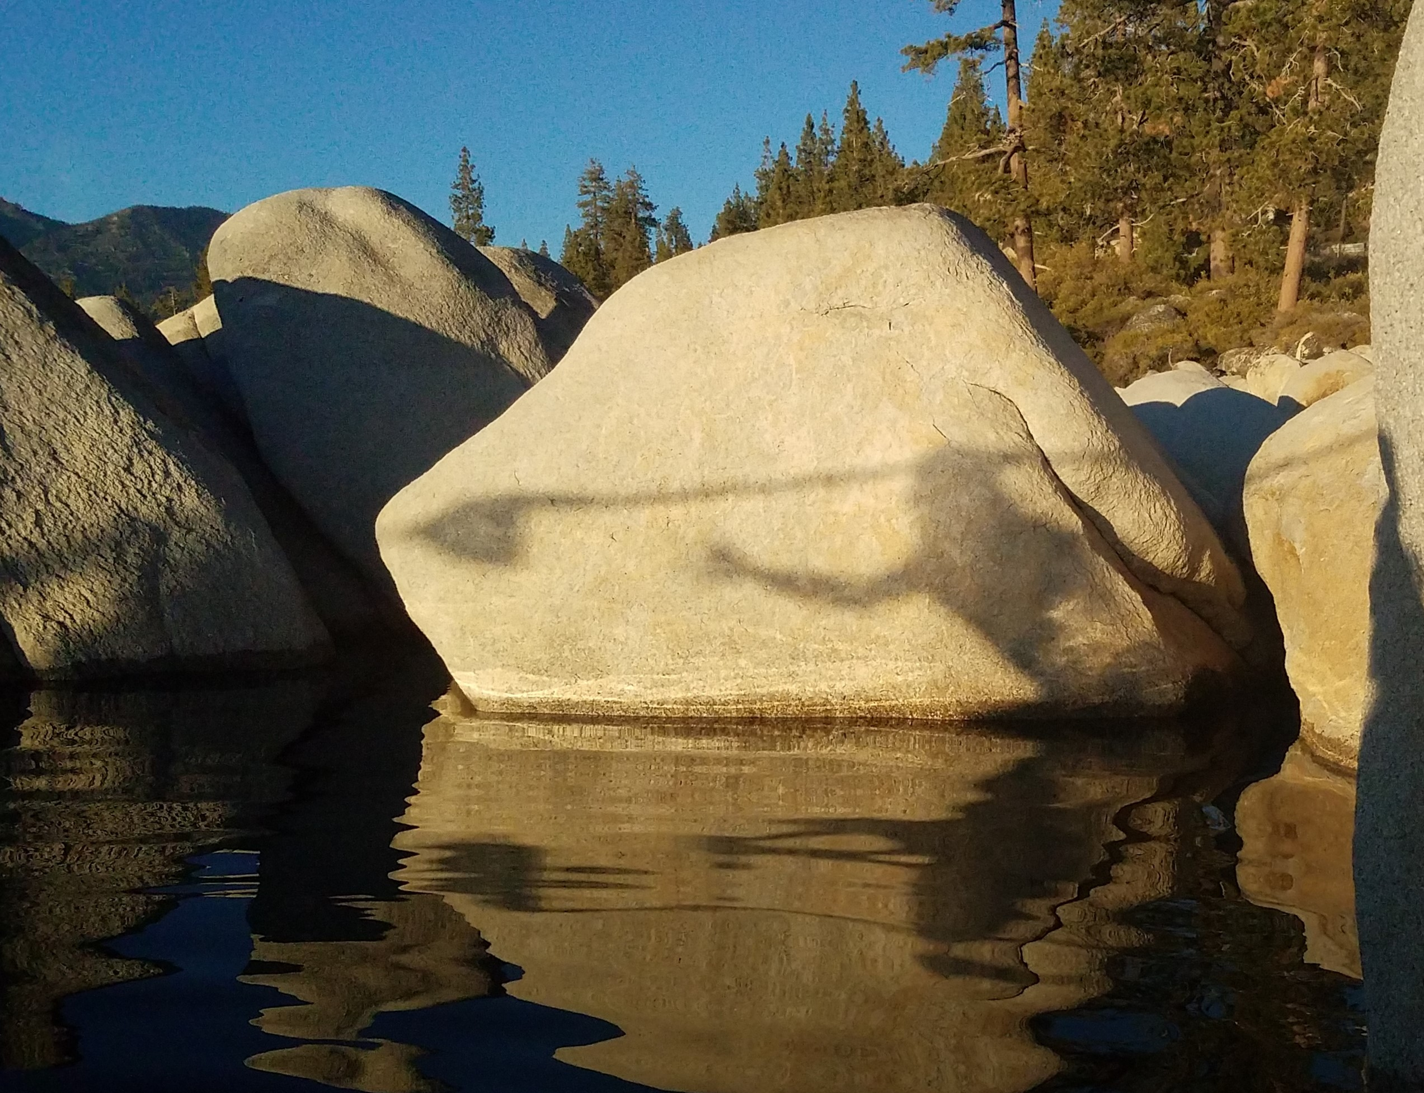
Awareness
Destination wants:
Preserve assets
Relevancy
Prosperity
Stability
Local well being
Traveler wants:
Feel welcomed
Sense of wonder
Value
Renewal
Special memories
Notes:
1- AWARENESS
What connects travelers desires to the destinations sustainability requirements? How can each be in the service to the long term viability and prosperity and enrichment of the other?
Tahoe DMO’s recently adopted a sustainability ‘pledge’ to promote visitor awareness…but…Who is guiding their behavior once they arrive and ?
Does the current Visitor Activity Menu consider and protect; land, water, plant, wildlife, air, culture, heritage and local well being?
Is their a collaborative hosting commitment between .org (non-profit), .com (business) and .gov (public) stakeholders?

Slide 6
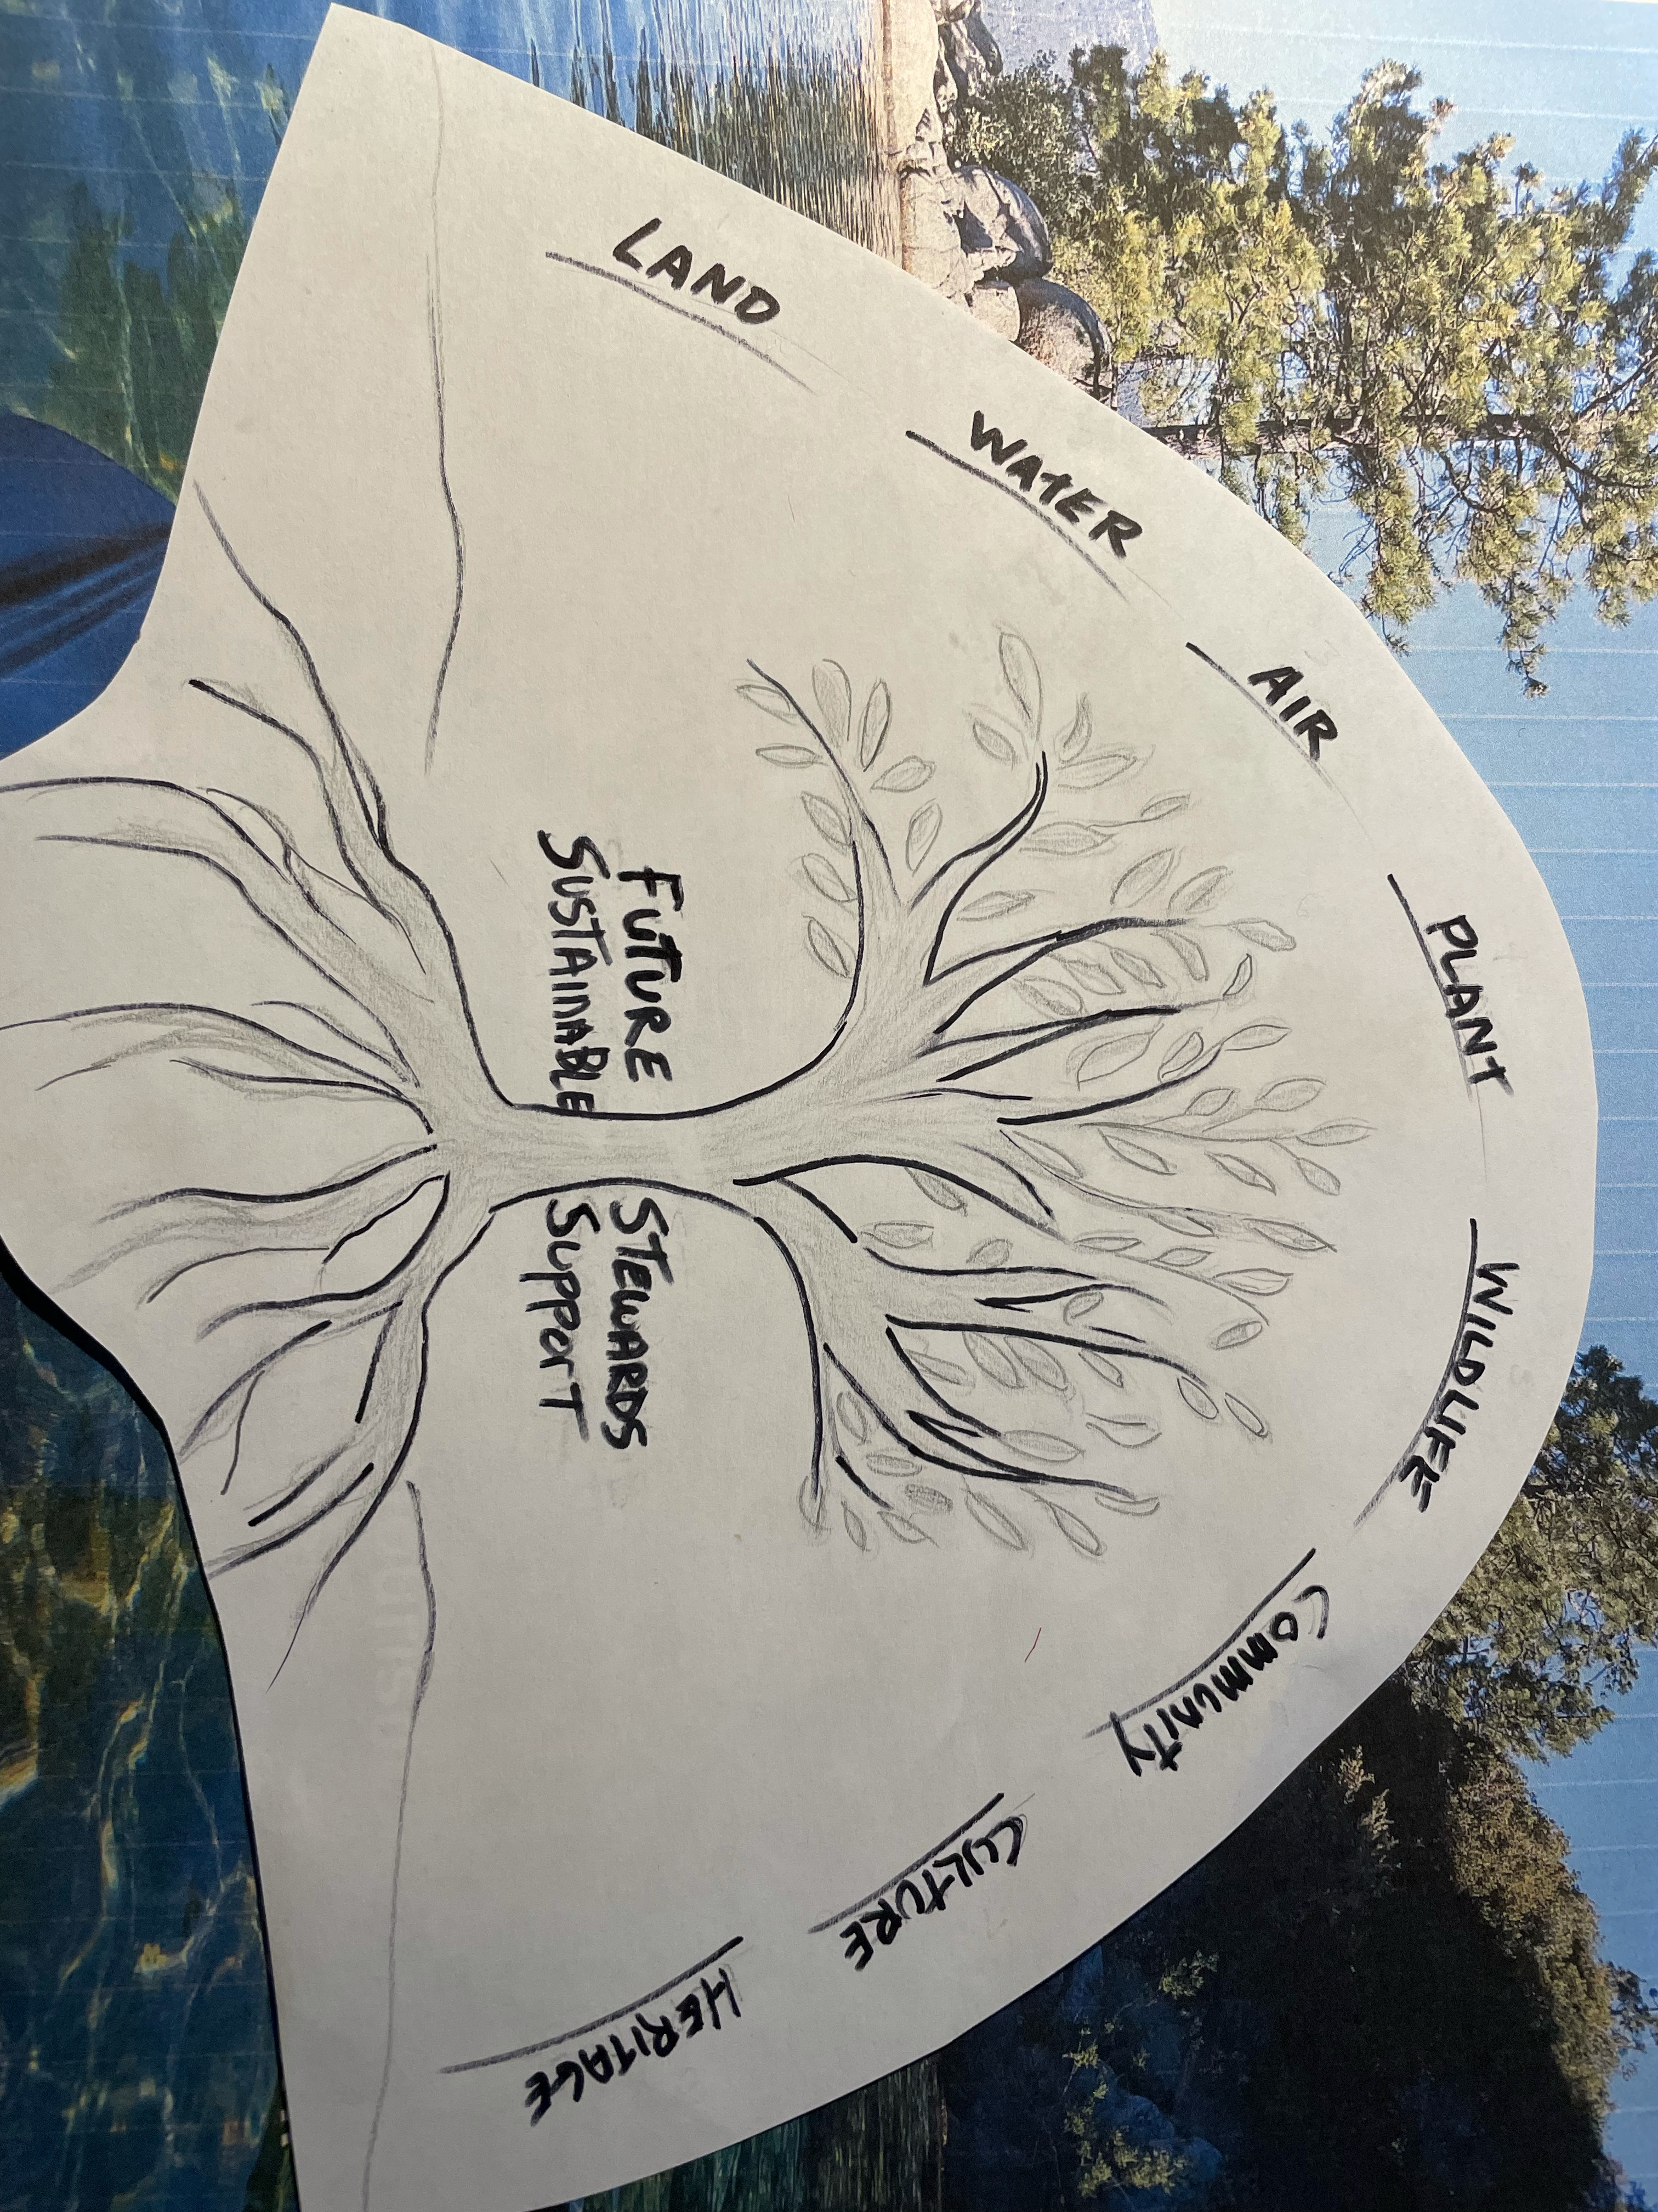
Education
?Carrying capacity
Indigenous Knowing
Notes:
2- EDUCATION
Visitor activity choices directs destination survival.
People travel to explore and experience the unique assets of the destinations 8 Worlds: Land, water, air, plant, wildlife, local community, culture and heritage. All visitor activities involve one or more of these 8 Worlds. How they are hosted will guide visitor expectations, behavior, memories and how they promote the destination to others.
Solution: Train a dedicated ground team (future leaders) to identify fun, meaningful recreational programs that can absorb the growing influx of travelers without further harming the Lake and the quality of life for residents, including wildlife.
like Bears

Slide 7
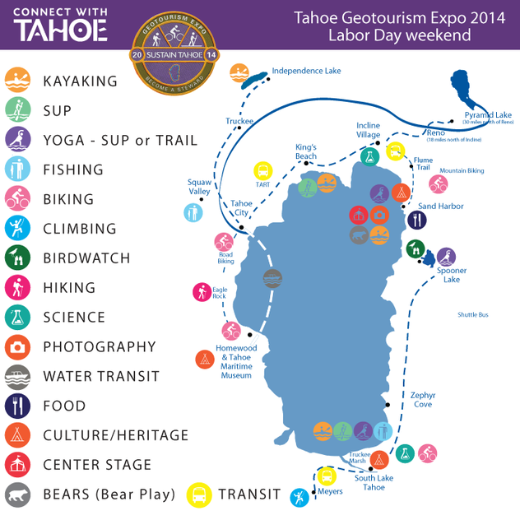
TriNomic hosting demonstrated by Sustain Tahoe
‘Tri-Nomic’ Implementation
What do they want?
What do they have?
What are they willing to do?
.org
.gov
Stewards
Docents
Educate
Stability
Resources
Support
.com
Customers
Funds
Pivot for $
Notes:
3) IMPLEMENTATION
"Trinomic“ (.org – NonProfits, .gov – Public agencies, .com – Business community) buy-in to support this pivot.
Leave one out? See you in court. Which I guess makes some people a lot of money, but locals (including wildlife), environment, commerce and travelers pay the price
Offer future generations an immersive field based study course stake in co-creating a visitor guidance system that will guide travelers toward activities that will not harm the Lake or quality of life for residents - including wildlife.
SustainTahoe.org demonstrated the value of hosting visitors to fun, meaningful immersive adventures: https://www.slideshare.net/jacquiechandler/2014-tahoe-geotourism-expo-2014-report

Slide 8
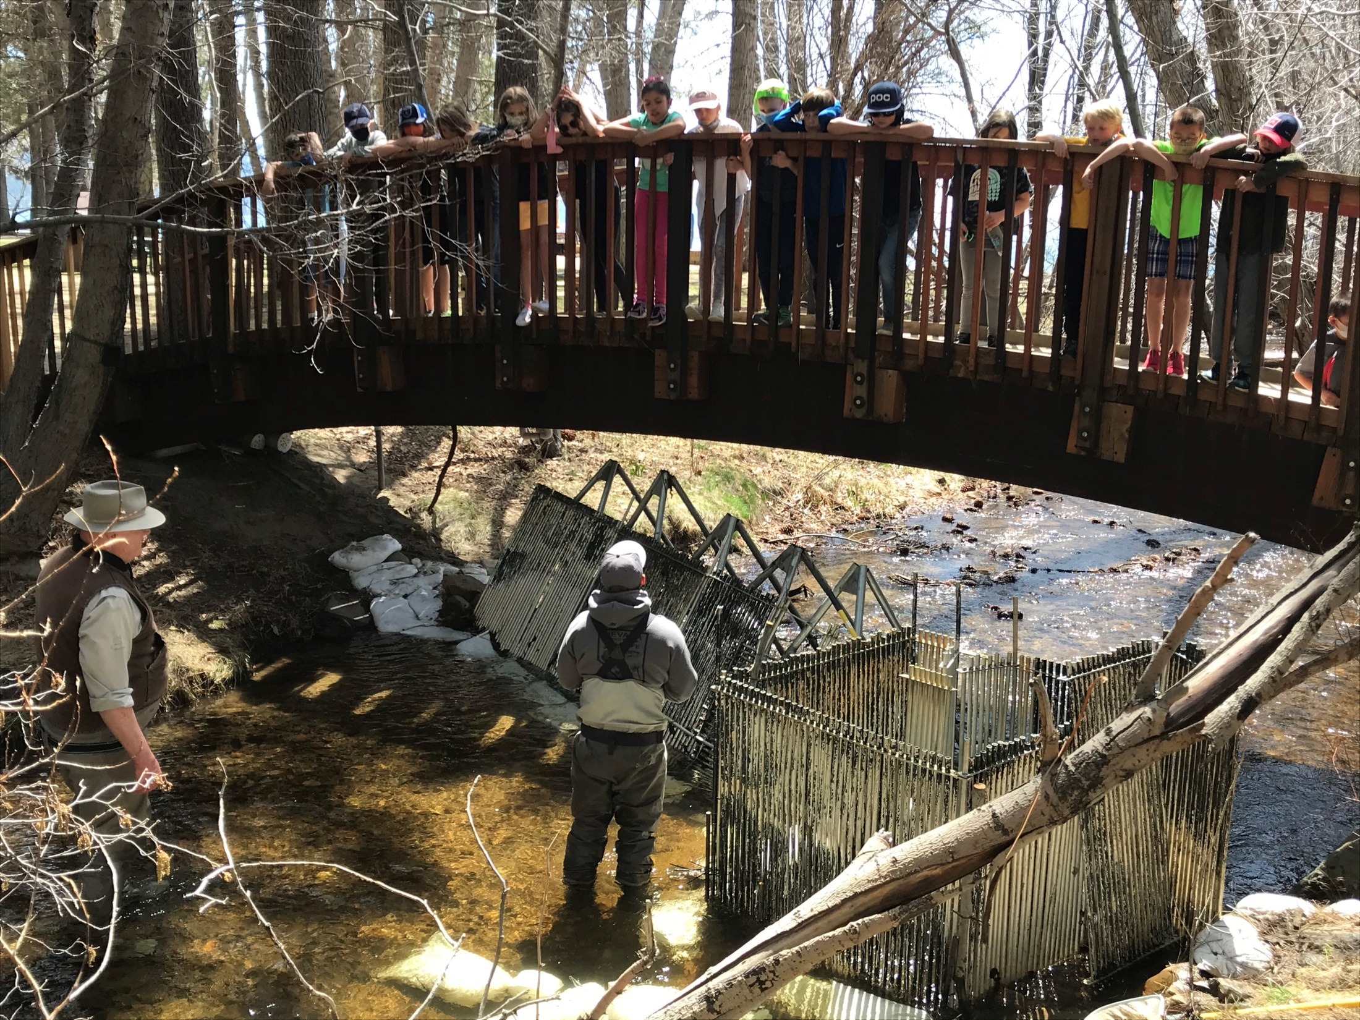
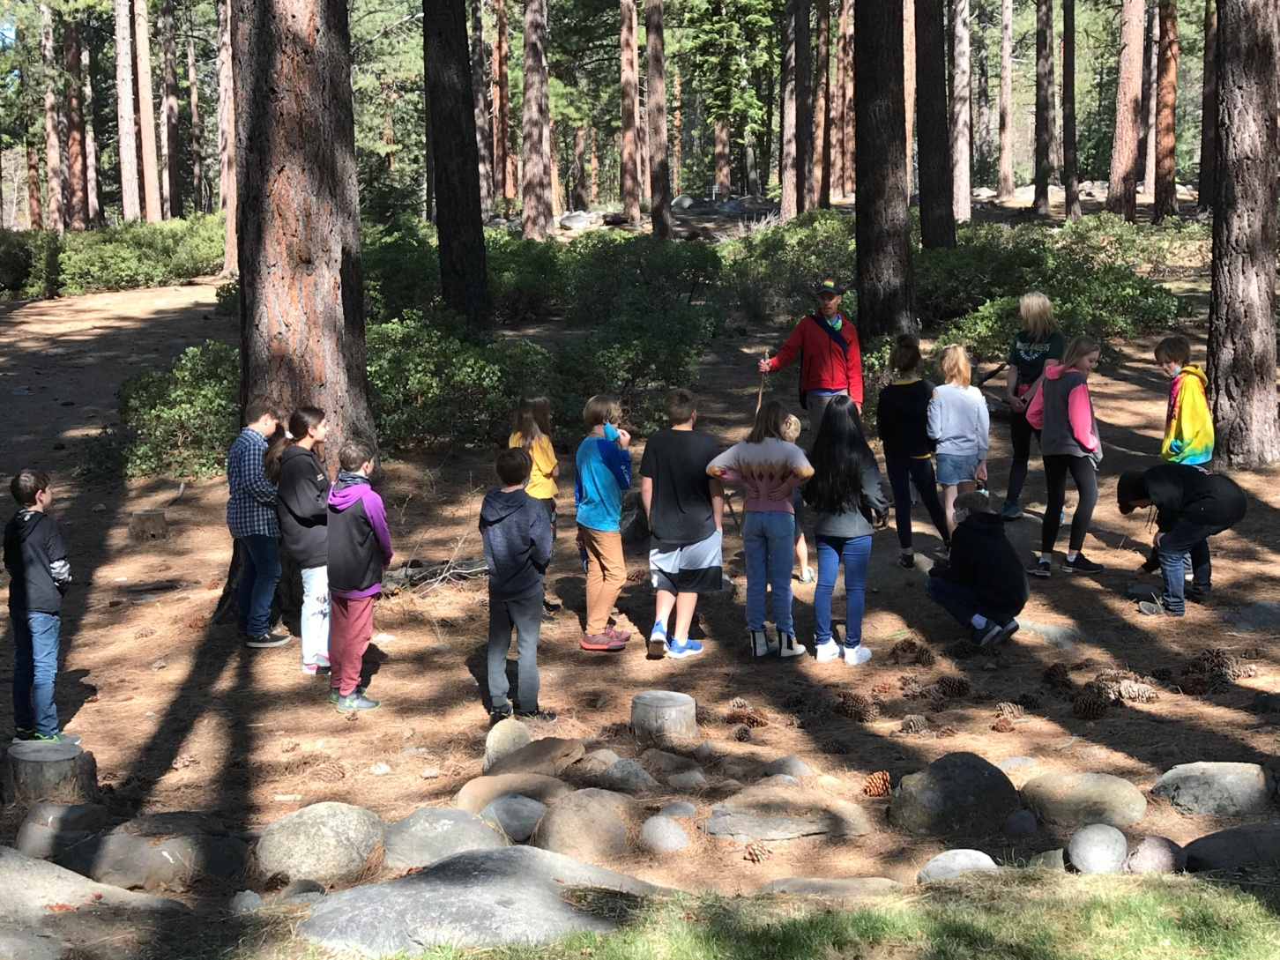
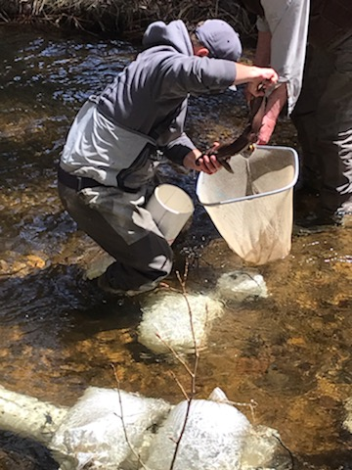
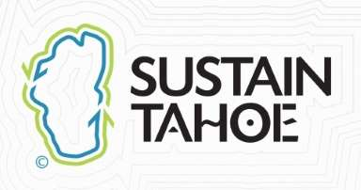
Tahoe is a natural stewardship learning lab
Notes:
Tahoe has everything to do this:
UC Davis- field-based Tahoe science classes.
Washoe indigenous leaders - 10,000 year relationship to the land…
Geotourism framework to guide and define a Sustainable Tourism and Stewardship Recreation Activity Menu

Slide 9
Potential Career Paths
Chamber of Stewardship Recreation
Sustainable Travel Manager
Conservation Rangers
Natural Resource Steward
Fair Market Travel Ambassadors
Conservation Concierges
Sustainable Fitness (K-12)
Notes:
New career paths and redefined DMO roles ensure these strategies, visitor menu and hosting protocols are sustained.

Slide 10
“…A program on Sustainable Tourism would be very valuable.
I was disappointed when I saw that UNR does not have a sustainability management program as I am interested in going to grad school for this. I think your proposed program would fill this space nicely and ignite some much needed sustainable ingenuity in the basin.
Again, thank you for the work you're doing. I am so early in my career but I hope to move in the direction of sustainable business / tourism and your work is very inspiring.”
Best,
Charlotte Mahoney
Sports America guide
Notes:
The future is ready.
Time to let them co-create the future they will inherit

Slide 11
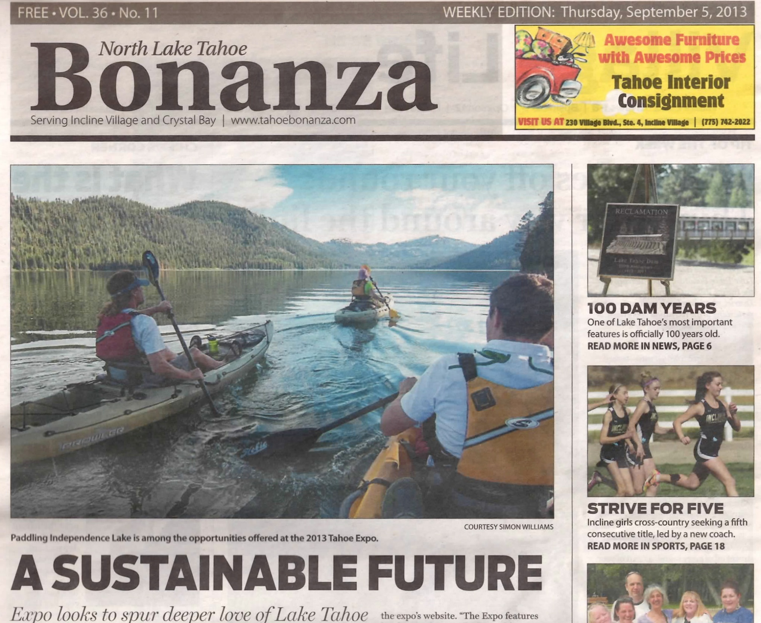
Sometimes…the best way forward is to look around first
Notes:
We, Sustain Tahoe, have been advocating and facilitating the adoption of Geotourism (destination stewardship) since 2007 and the results can be seen throughout the region (via Visitor Authorities, agencies and other non-profits, many who have been advocating complimentary strategies).

Slide 12
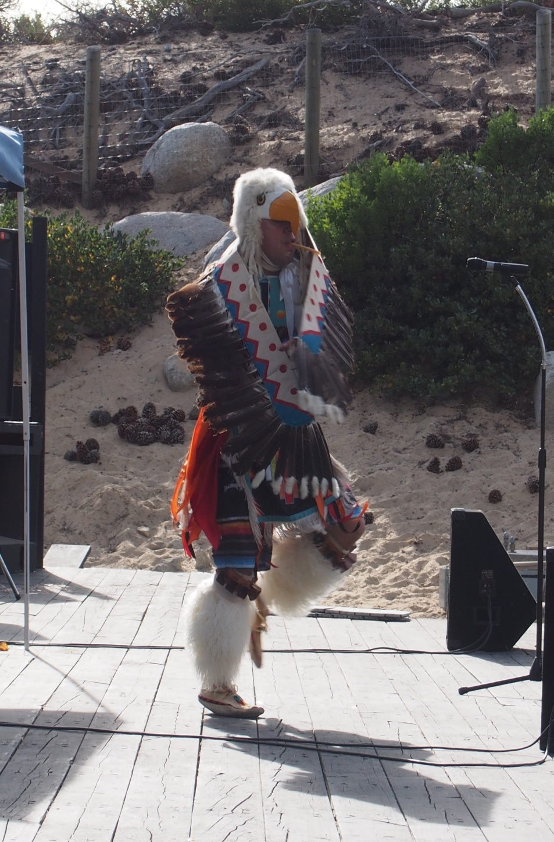
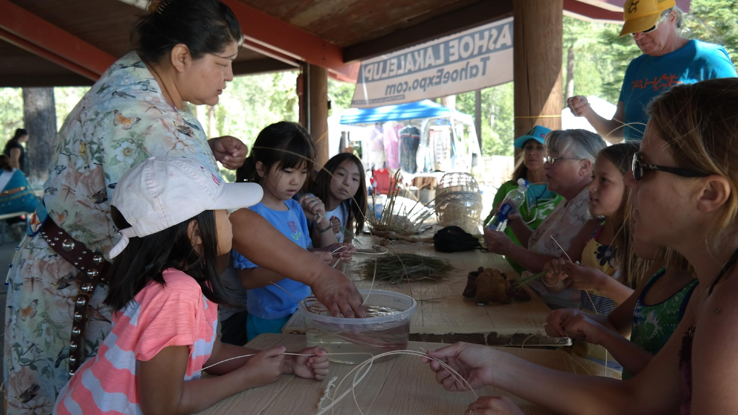
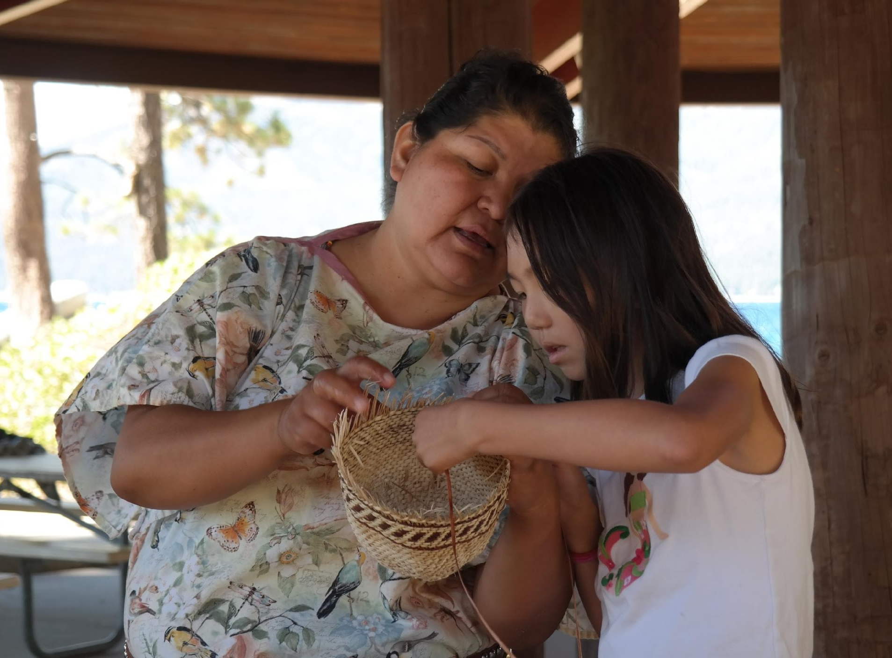
Tahoe Expo demonstration of meaningful immersive activities that educate visitors. Washoe Laka'lelup 2014. Ben Rupert above preforming traditional "Eagle Dance"
Notes:
Critical to connect the program with the 10,000 years of the Washoe and Paiute’s stewardship legacy.
The visitors and locals alike appreciated the immersive experience we provided and liked the format of guided adventures that brought them closer to the 8 Worlds of Tahoe.

Slide 13
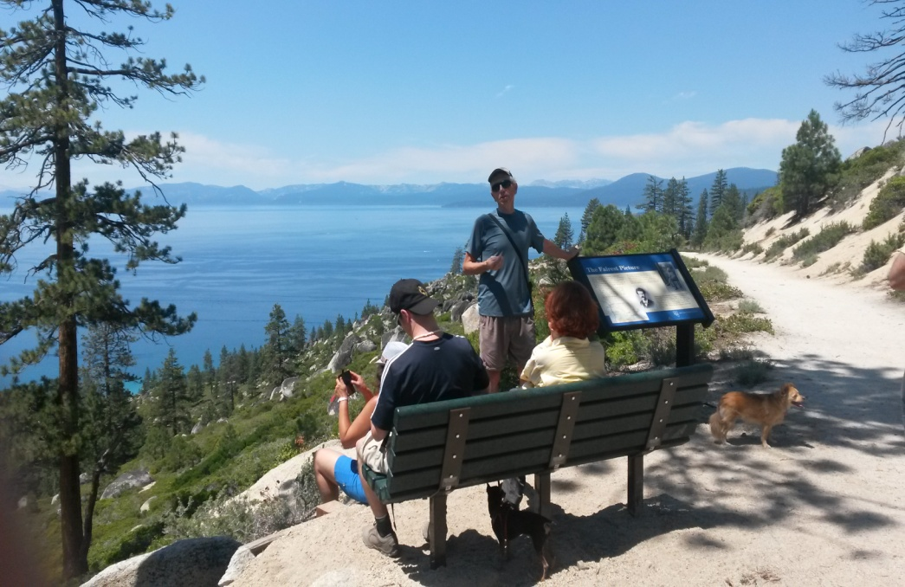
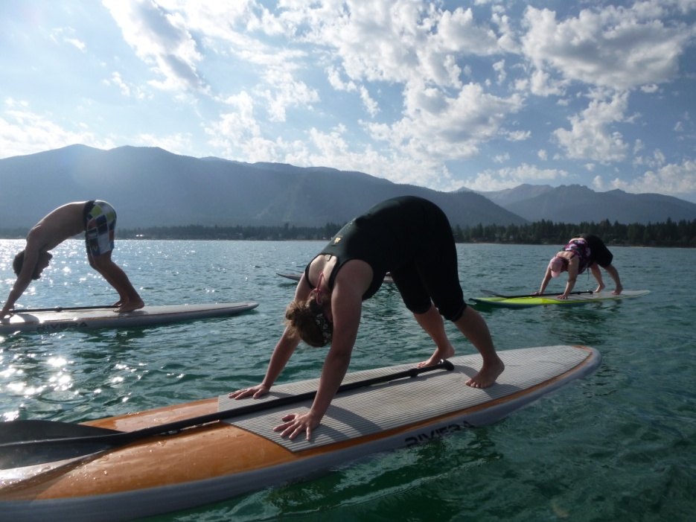
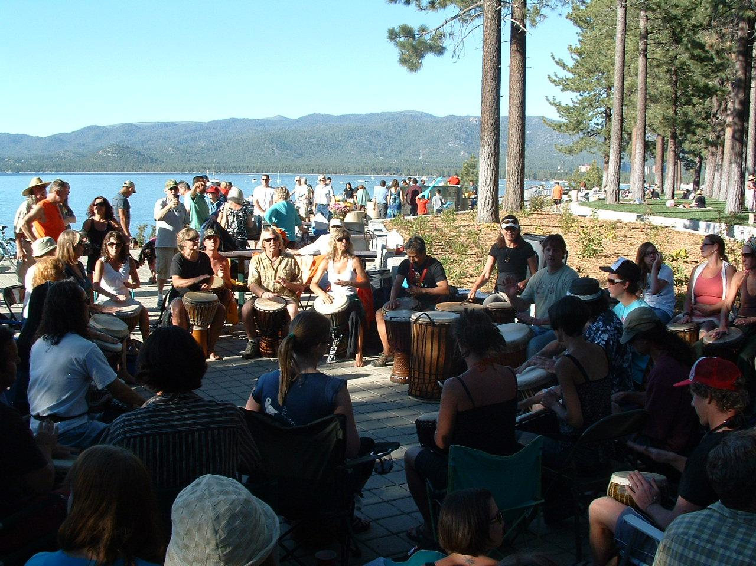
Geotourism menu highlights: land to water transit, guided Heritage Hikes, SUP Yoga, Paiute Drum Circle. We already have the ingredients for a collaborative effort
Notes:
SustainTahoe.org spent 5 years (2010 to 2014) demonstrating what a sampler of what a sustainable tourism visitor menu might offer. Fun, meaningful and immersive activities would be identified and developed in the program. Our Tahoe Expos had SNC student enthusiastic involvement (Ref article in 2012 SNC Eagle)

Slide 14
When the Future looks back…will it ask:
How did you do it? …or…Why didn’t you do something?
Notes:
Your choice Our choice
The future will inherit what we decide

